Slide 1
Credit Card Lead Prediction (Analytics Vidhya Job-A-Thon)
Shailee Singh
28/05/21 – 30/05/21

Slide 2
Agenda
To identify the customer segment from the existing customer base with the probability of buying credit card.

Slide 3
Approach
Understand the Problem Statement & Import Packages and Datasets.
Perform EDA (Exploratory Data Analysis) - Understanding the Datasets :
Explore Train and Test Data and get to know what each Column / Feature denotes.
Check for Imbalance of Target Column in Datasets.
Visualize Count Plots & Unique Values to infer from Datasets.
Remove Duplicate Rows from Train Data if present.
Fill/Impute Missing Values Continuous - Mean/Median/Any Specific Value & Categorical - Others/ForwardFill/BackFill.

Slide 4
Approach
Feature Engineering
Feature Selection - Selection of Most Important Existing Features.
Feature Creation - Creation of New Feature from the Existing Features.
Split Train Data into Train and Validation Data with Predictors(Independent) & Target(Dependent).
Data Encoding - Label Encoding
Create Baseline ML Model for Binary Classification Problem
Improve ML Model,Fine Tune with MODEL Evaluation METRIC - "ROC_AUC" with k-FOLD Cross Validation and Predict Target “Is_Lead"
Result Submission, Check Leaderboard & Improve "ROC_AUC" Score

Slide 5
Insights
Age:
The number of interested customer is maximum in the "46 to 55" years age group.
With increase in age, the number of interested customers gradually decreases.
Vintage:
Vintage column has almost no correlation with Customer Response.
That means a customer who is connected to the company for a long time doesn't necessarily mean that he/she will be interested in taking the credit card.
Average Account Balance:
Customers showed more interest in credit card with increase in the average balance amount.
Occupation:
“Self Employed” category showed maximum interest in Credit Card
“Entrepreneur” category has more number interested customers than non interested

Slide 6
Insights
Credit Product:
Customers with no active credit products have shown more interest in Credit Card than the customers with an existing credit product/s.
Active Customers:
Inactive Customers have shown more interest in Credit Card than the existing Active Customers.
Channel Code:
Most used Channel code is X1
Interestingly, channel codes X2 and X3 have more Interested customers.

Slide 7
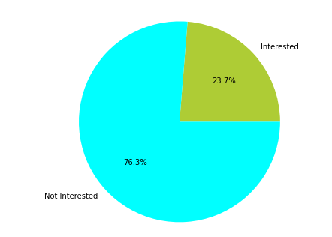
Interested vs Non Interested Customers
This is a highly imbalanced dataset.
The number of customers interested is only 23.7% whereas the number of customers
not interested is 76.3%

Slide 8
Algorithms
It’s a classification problem, with Stratified KFold
Algorithms used:
Light GBM Classifier
XG Boost
CatBoost
Obtained the best result using Light GBM algorithm

Slide 9
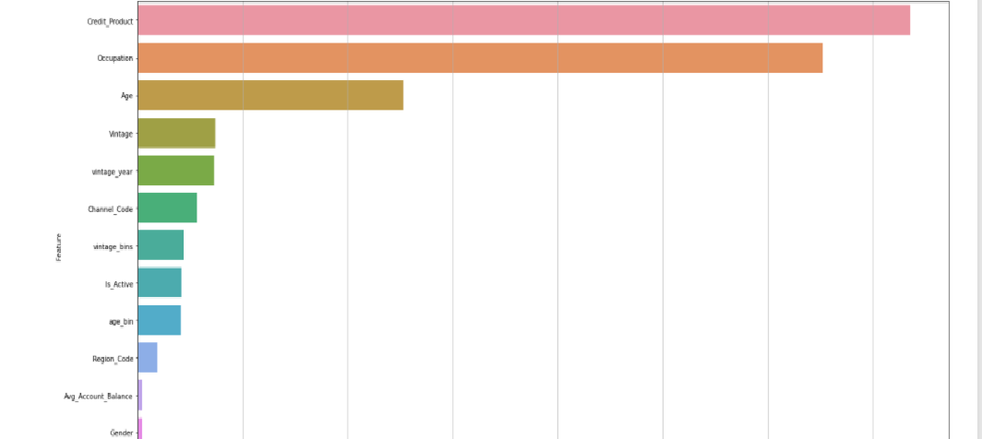
Feature Importance
Credit Product is the most important feature.

Slide 10
Thank You

